Slide 1



Thinking about State Capacity and Industrial Policy: South Africa in Comparative Contexts
Mini-series on Rethinking the Role of States in the 21st Century
Jewellord T. Nem Singh
Principal Research Fellow in Global Political Economy
University of Sussex

Slide 2
Outline of the Lecture
State Capacity debates and their policy implications
Industrial Policy in Democratic Contexts
China as a new partner in Africa

Slide 3
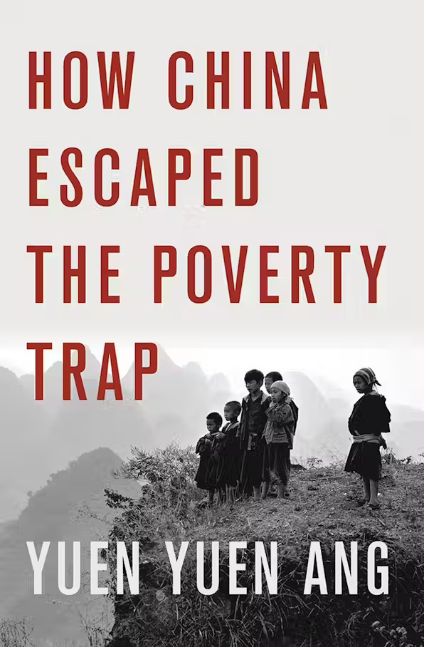
I. State capacity debates and their policy implications
State capacity is both a cause and consequence of economic development
  State strength was key to economic planning, centralization of power, and ability to create reciprocal bargains with social and economic groups
  China example: development is a co-evolution between market and bureaucracy
  The relationship between economic development and bureaucratic development is mutual and dynamic, not linear. Markets and institutions adapt to each other over time.

Slide 4
State capacity-building as a process
Non-fungible capacity: State capacity is not a single quality that can be applied universally. Capacity in one area, such as economic development, does not automatically translate to other areas like social inclusion or environmental conservation.
Temporal dimension: The features of bureaucracy that are effective for development change over the course of a country's growth.
Adaptive improvisation: Successful state-led development often involves "directed improvisation"—an adaptive approach where institutions are refashioned in response to specific challenges, rather than being a rigid adherence to a pre-existing model.
Context matters: The historical origins and political decisions of a state significantly shape its capacity to meet development goals.
Two types of institutions: Conventional wisdom holds that Weberian bureaucracy is essential for growth, but Ang argues that initial market-building often relies on "weaker," more adaptive institutions, which are then later replaced by more formal Weberian structures to preserve the market.

Slide 5
II. Industrial Policy in Democratic and Non-democratic contexts
Success of East Asian industrialization was based on specific political choices underpinned by historical constraints
Industrial policy has returned in both democratic and non-democratic contexts

Slide 6
Three major types of industrial policy
  Functional – property rights, macro-economic stability, education, infrastructure, flow of labour
  Capital accumulation / mobilization of resources – trade measures (e.g. quotas), fiscal incentives (excise taxes), subsidized credit for domestic capital, FDI (promotion of specific sectors, local capacities), and infrastructure for market promotion (FTAs, complementary export info)
  Technology promotion – tariff coordination between upstream and downstream industries, promoting FDI to create spill over effects, infrastructure, education, other types of support
Source: Doner et. al. 2021, Chapter 3.

Slide 7
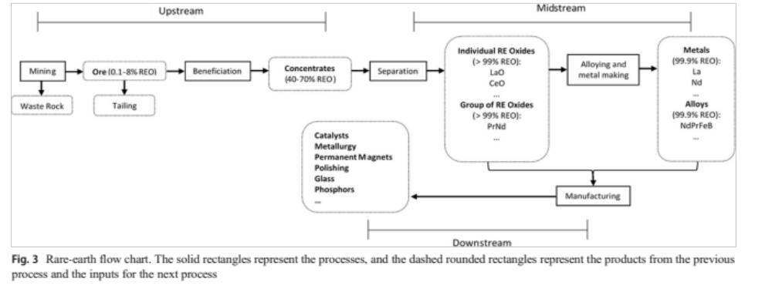
Example: Supply Chain of REE-Permanent Magnet in China
China overcame the resource curse through value addition across the supply chain

Slide 8
China as a New Development Partner in Africa
Bilateral trade increased steadily over the decades with China becoming the region’s largest trading partner (two-way trade with the continent reached US$ 282 billion in 2023).
China is the destination of around 20% of Africa’s exports and the source of about 16% of its imports.
Commodities – metals, minerals and fossil fuels – account for about three-fifths of the region’s exports while its imports are primarily of manufactured products, electronics, and machinery.
Angola was the region’s largest exporter to China (crude oil), followed by South Africa (iron ore) and Sudan, Congo and the DRC (crude oil and copper) – together these countries accounted for over 2% of the continent’s GDP in 2022 and 69% of total export value to China for the period 2000-2022.
As in the case of Latin America, the patterns of trade between China and Africa reinforce the economic structure of the region – namely Africa’s exports consist mainly of commodities – primarily fossil fuels and minerals – while Chinese exports to the region are comprised of high value added, manufacturing goods.

Slide 9
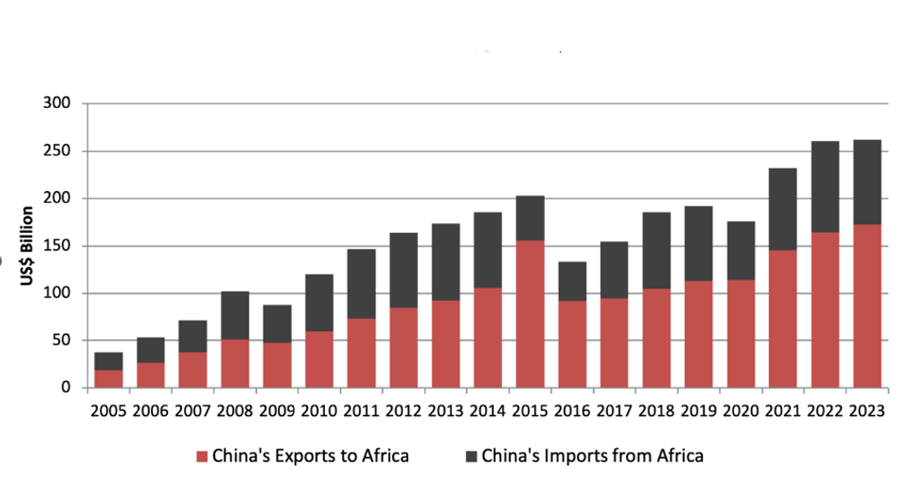
China-Africa Trade, 2005-2023 (Billions of US$)
Source: China-Africa Research Initiative, John Hopkins School of Advanced International Studies, 2024.

Slide 10
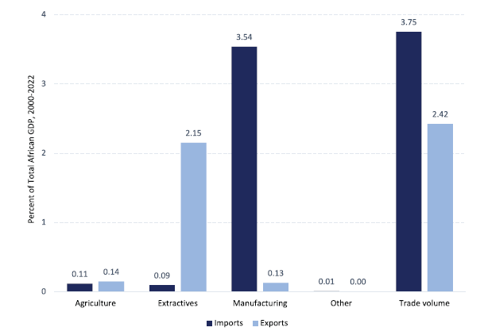
China-Africa Bilateral Trade by Sector, 2000-2022 (Percentage of Total)
Source: Moses et. al., 2024, p. 9.

Slide 11
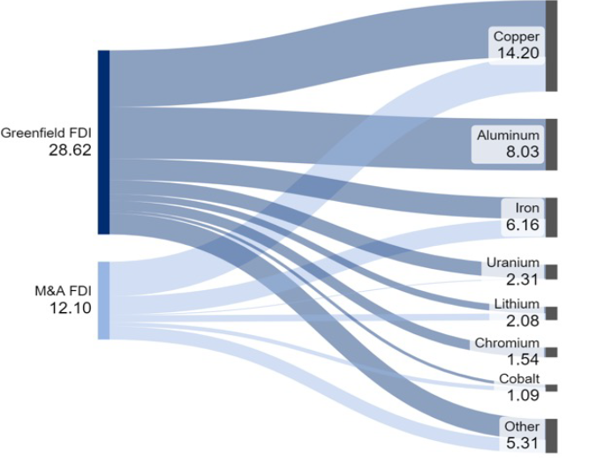
Chinese FDI - Minerals’ Mining and Processing
The overwhelming majority of Chinese FDI in the region flows towards the energy sector (fossil fuels) and the extraction of minerals, primarily transition minerals. On mining and processing, Chinese FDI focuses on copper (US$ 14.20 billion), followed by aluminium (US$ 8.03 billion), iron ore (US$ 6.16 billion), and uranium (US$ 2.31 billion).
Source: Moses et. al., 2024

Slide 12
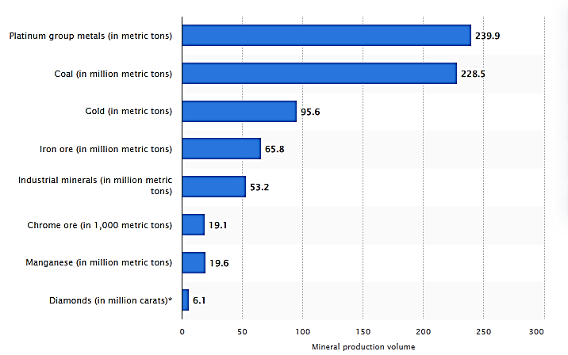
South Africa Mineral Production by Commodity, 2023 (Volume)
Source: Statista, 2024

Slide 13
China-South Africa Relations
China is South Africa’s main trading partner, having surpassed the EU in 2023 - bilateral trade between the two countries peaked in 2021 when it reached a record US$ 54 billion
South Africa trade with China, however, follows the same pattern encountered in other African and Latin American counties – it exports primarily raw commodities, such as minerals and metals, while imports manufactured, high value-added products.
In 2022, the main products that South Africa exported to China were gold, diamonds, and platinum metals. In turn, the main products it imported from China were broadcasting equipment, computers, and electric batteries.
Trade between the two countries continues to expand as exports from South Africa to China have increased an average 5.6% per year over the past 5 years while Chinese exports increased approximately 8.9% during the same period.

Slide 14
South Africa Exports to China by Product Group, 2010-2022 (Billions of US$)
Source: WITS, 2024

Slide 15
Chinese FDI in South Africa
South Africa is also the country with the largest amount of Chinese investment in Africa with the total stock of Chinese FDI in South Africa amounting to US$ 5.84 billion in 2023.
Compared to the rest of the African continent, Chinese FDI in South Africa has been more diversified across sectors, targeting the mining, auto, and petroleum/energy sectors. This is in part attributed to South Africa’s more developed and diversified economic structure.
Other notable areas of Chinese investment include the telecommunications and food processing sectors, with recent investments also directed towards manufacturing consumer goods like electronics and household appliances.
In the mining sector, Chinese entities invested US$ 3.85 billion between 2005 and 2020, accounting for 25 percent of China’s total FDI in South Africa.
The mining sector received the second largest share of Chinese investment after the financial sector.
Chinese investment comes primarily from Chinese state-owned enterprises although other sources, such as private companies and public and sovereign wealth fund, also play a role. These investments focus on minerals such as chrome, steel, platinum, gold, copper, and iron ore.

Slide 16


Thank you!
Interested in our project?
Write to me.
Visit my webpage: https://nemsingh.com/
Our substack: https://criticalrawmaterials.substack.com/
Project website: https://www.miningfordevelopment.eu
Follow us on twitter: @JNemSingh @GRIP_ARM
My email: j.nemsingh@sussex.ac.uk

